Slide 1

Sports Analytics III
Produced by Dr. Mario
UNC STOR 538

Slide 2
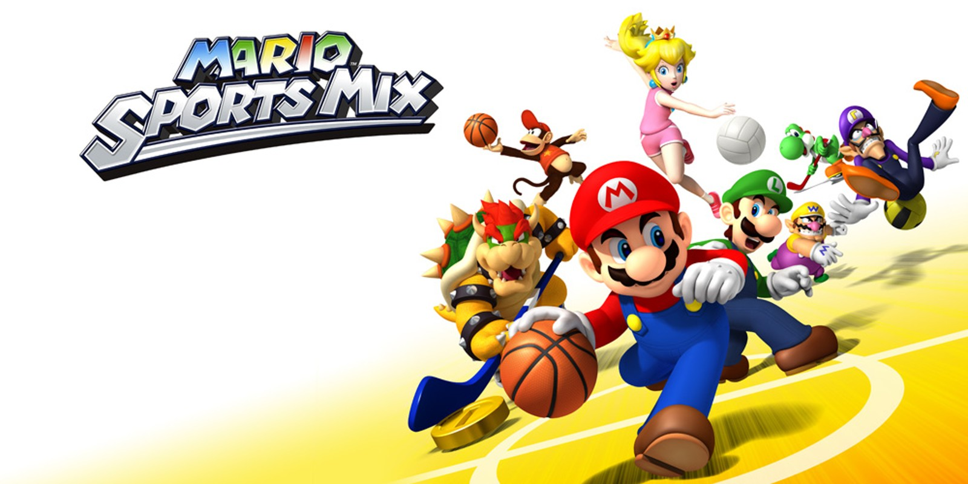
Industry Past
Sports Analytics Use Survey (2013)
Sample of 27 People (NFL, MLB, NBA, EPL)
How Many Different Sources?
1-2 (6.7%)
3-4 (33.3%)
5-6 (13.3%)
>6 (46.71%)

Slide 3
Industry Past
How Much Data is Centralized?
All (31.3%)
Most (37.4%)
Some (31.3%)
How Much Data is Dependent on One Person?
Some (50.0%)
Most (43.7%)
All Data Centralized (6.3%)

Slide 4
Industry Past
Is Data Checked for Errors?
Always (31.3%)
Usually (37.5%)
Sometimes (18.8%)
Occasionally (6.1%)
Rarely (6.3%)
How Many Database Programmers are Employed?
0 (37.5%)
1-2 (50.0%)
3-4 (0.0%)
>5 (12.5%)

Slide 5
Industry Past
How Many Statistical Analysts are Employed?
0 (20.0%)
1-2 (66.6%)
3-4 (0.0%)
>5 (13.3%)
Roadblock: Difficulty Identifying Strong Applicant
Difficulty in Both Hiring and Evaluating

Slide 6
Industry Past
Clear Process for Hiring/Evaluating Analysts
Strongly Agree (13.3%/14.3%)
Somewhat Agree (13.3%/14.3%)
Neutral (26.7%/28.6%)
Somewhat Disagree (13.4%/21.4%)
Strongly Disagree (33.3%/21.4%)
Analytic Resources in Line with Strategic Game Plan
Strongly Agree (26.7%)
Somewhat Agree (33.3%)
Neutral (33.3%)
Strongly Disagree (6.7%)

Slide 7
Industry Present
Value Placed on Sports Analytics
Business Research Company Analysis
Global Sports Industry $486.61B to $512.14B
Actual CAGR of 5.2% in 2023
Expected to Grow to $623.63B in 2027 (CAGR 5%)
Deloitte Article Industry Trends for 2023

Slide 8
Industry Present
Value Placed on Sports Analytics
Grand View Research on Sports Analytics Market
Valued at $2.73B in 2022 and $3.52B in 2023
Expected CAGR Between 2023 and 2030 is 22.3%
Software Segment Dominates at 61% of Market
Services Segment Expected to Grow by 19%
On-Field Analytics (61%) Dominates Off-Field Analytics
$Projection in 2030=3.52∗(1+CAGR)^7$ =14.41
$14.41B
$2.73B
$3.52B
2022
2023
2030

Slide 9
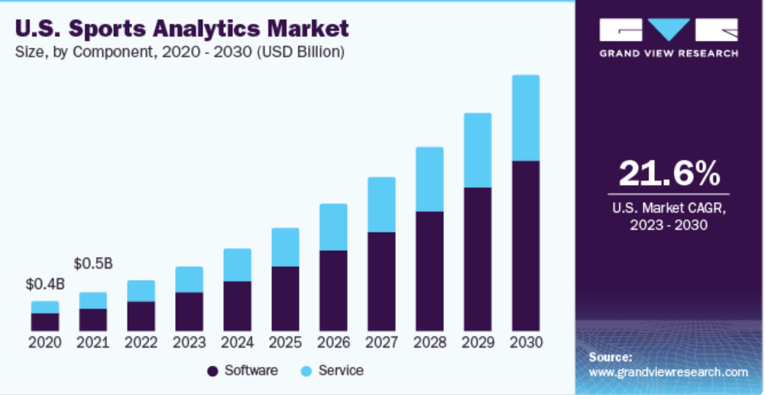
Industry Present
Value Placed on Sports Analytics
Grand View Research on Sports Analytics Market

Slide 10
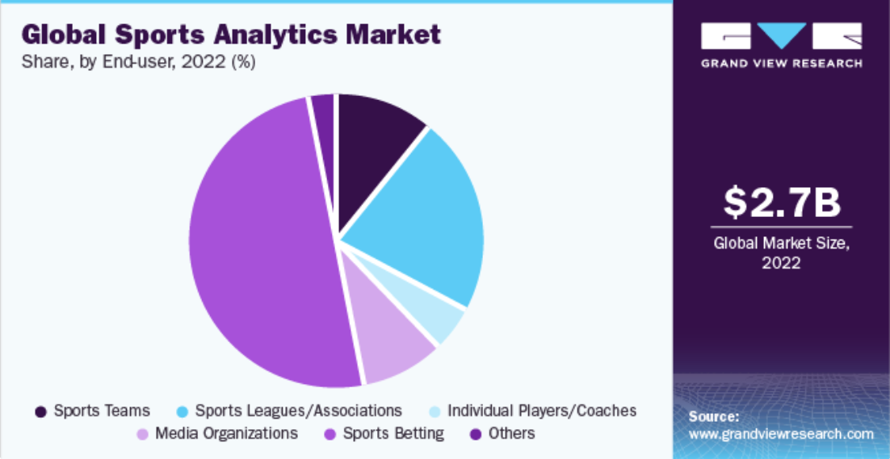
Industry Present
Value Placed on Sports Analytics
Grand View Research on Sports Analytics Market

Slide 11
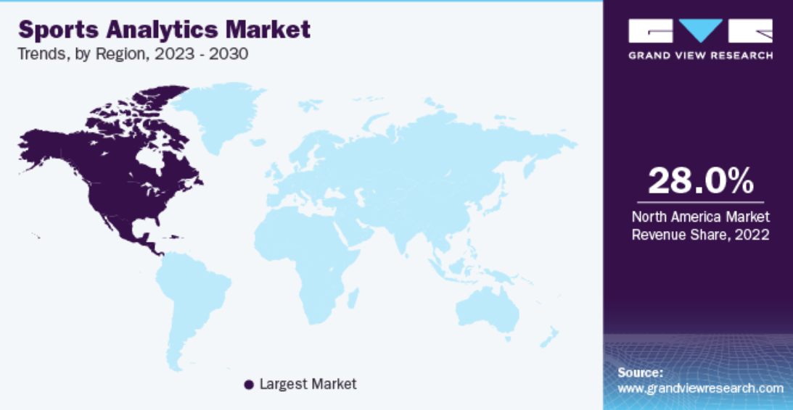
Industry Present
Value Placed on Sports Analytics
Grand View Research on Sports Analytics Market

Slide 12
Industry Present
Value Placed on Sports Analytics
Grand View Research on Sports Analytics Market
Agile Sports Analytics, LLC
Catapult Sports
ChrynoHego Corporation
Deltatre
Experfy Inc.
Genius Sports Group
IBM Corporation
Oracle Corporation
SAP SE
SAS Institute Inc.
Sportradar AG
Stats Perform

Slide 13
Industry Present
Modern Applications of Sports Analytics
Helping the Team Win
Automated Video Analysis (Lincoln City, UK Football)
3D Depth Camera (NBA)
Wearable Technology (NBA, NHL)
Improving the Fan Experience
Analysis of Digital Engagement
Sentiment in Social Media
Analysis of Fan Behavior in Stadium (New England Patriots)
Wireless Internet and Phone Apps
Apps Supply Game Analytics, Parking Information, Promotions, and Traffic Information to the Fans (NFL)

Slide 14
Industry Present
Modern Applications of Sports Analytics
Benefiting Other Stakeholders
Tracking Fan Behavior Outside the Stadium
Telecommunication, Retailers, Payment Providers, Ticket Agencies, and Sponsorships
Adapt to Quick Changes in Consumer Behavior
Optimizing the Back-Office
HR Practices
Game Scheduling
Supply Chain Management and Logistics
Marketing and Promotions
Procurement of Goods and Services

Slide 15
Industry Present
Modern Applications of Sports Analytics
Advancing Sports Gambling
Supreme Court Ruling Previous Statute Violated 10th Amendment (Murphy v. National Collegiate Athletic Association)
States Free to Legislate Gambling
Improvement of Gambling Products
Data Aggregation and Visualization for Bettors
Develop Daily Fantasy Sports

Slide 16
Your Industry Future
Prerequisites by Howard Hamilton
(Soccermetrics)
Technical Skills
Mathematics (Linear Algebra/Probability Essential)
Statistics (Frequentist and Bayesian Perspectives)
Machine Learning (Supervised and Unsupervised)
Programming (R/Python, Data Structures, OOP)
Databases
Visualization
Socials Skills, Ethics, and the Law
Knowledgeable About All Aspects of the Sport

Slide 17
Your Industry Future
Real Jobs (Indeed)
Data Engineer, Sports Analytics for SIG
Data Science in Python
Large Data Storage and Data Processing
PhD, Master’s, or Bachelor’s
Newest Business Area
Sports Scientist, Chicago Women’s Soccer Academy
Bachelor’s or Master’s in Exercise Science
Experience with Sports Science Technologies
Deliver Daily Reports and Provide Data-Driven Feedback

Slide 18
Your Industry Future
Real Jobs (Indeed)
Sports Performance Analyst, Baltimore Orioles
Primarily Data Management/ Organization
Requirements are Unknown
Sports Injury Data Scientist, RWE Agile Analytics
Part of IQVIA
SQL, Python, SAS, R
Familiar with Basic Statistical Analyses
Bachelor’s (6-8 years experience)
Master’s (3-5 years experience)

Slide 19
Your Industry Future
Real Jobs (Indeed)
Sports Science Coordinator, Houston Texans
Master’s Required
Expected to Constantly Learn
MS in Sport Performance
SQL, Statistics, R/Python
Machine Learning and Time Series Methods
Professor of Data Analytics, University of Tulsa
Focus on Sports Analytics
PhD and Research Background in Sports
College of Business

Slide 20
Your Industry Future
Real Jobs (Indeed)
Analyst, Club Business Operations for MLB
Quantitative Market Analyses
BS Degree in Business Related Field
Excel, PowerPoint, SQL
Exceptional Data Evaluation Skills
Business Analyst, Sports & Entertainment for Aramark
Hospitality Company for Many Industries
Data Visualization with Tableau or PowerBI
Exposure to Some Programming Language

Slide 21
Your Industry Future
Real Jobs (Indeed)
Analyst, Baseball Operations for Giants
Perform Statistical Analyses
Collaboration with Software Engineers
BS in Quantitative Field
R, SQL, Python
Director of Data Science, DICK’S Sporting Goods
MS in Stats, Math, Econ, etc.
10-15 Years Experience
Proficient in SQL, R, Python, or SAS
Cloud Computing Environments
Lead Team of Data Science Managers and Data Scientists

Slide 22
Your Industry Future
Conferences
MIT Sloan (March)
International Sports Analytics Conference (July)
UConn Sports Analytics Symposium (April)
OSU Sports Analytics Conference (April)
Carnegie Mellon Sports Analytics Conference (?)
New England Symposium on Stat. in Sports (2025)
Great Lakes Data and Analytics (April)
International Conference on Sports Analytics and Data Visualization (August)

Slide 23
Final Inspiration
Defense wins championships.
Offense wins contracts.
Be offensive.
- Mahatma Mario

